Slide 1
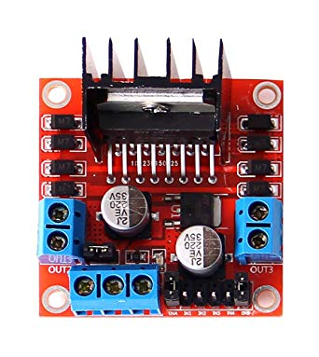
Motor Driver
L298N

Slide 2
Voltage regulator jumper
Vout 1
Vout 4
Vout 2
Vout 3
12V
GND
IN1
IN4
ENB
5V
ENA
IN2
IN3
(Regulated
voltage)

Slide 3
Voltage regulator jumper
Vout 1
Vout 4
Vout 2
Vout 3
12V
GND
IN1
IN4
ENB
5V
ENA
IN2
IN3
(Regulated
voltage)

Slide 4
Voltage regulator jumper
Vout 1
Vout 4
Vout 2
Vout 3
12V
GND
IN1
IN4
ENB
5V
ENA
IN2
IN3
(Regulated
voltage)

Slide 5
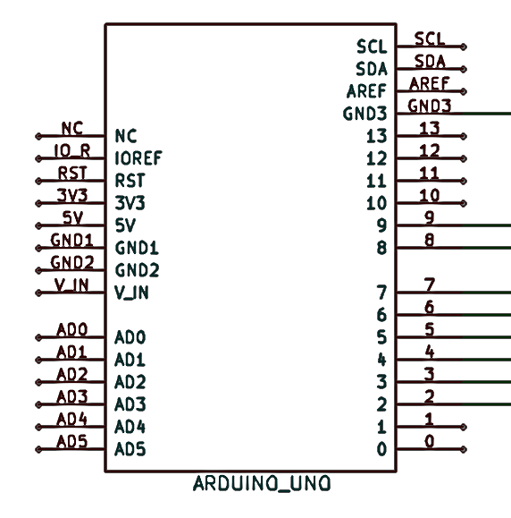
Voltage regulator jumper
Vout 1
Vout 4
Vout 2
Vout 3
12V
GND
IN1
IN4
ENB
5V
ENA
IN2
IN3
(Regulated
voltage)

Slide 6
POWER!!!!!!!!!!!
Voltage regulator jumper
Vout 1
Vout 4
Vout 2
Vout 3
12V
GND
IN1
IN4
ENB
5V
ENA
IN2
IN3
(Regulated
voltage)
Lipo Battery

Slide 7
POWER!!!!!!!!!!!
Voltage regulator jumper
Vout 1
Vout 4
Vout 2
Vout 3
12V
GND
IN1
IN4
ENB
5V
ENA
IN2
IN3
(Regulated
voltage)
Lipo Battery

Slide 8
POWER!!!!!!!!!!!
Voltage regulator jumper
Vout 1
Vout 4
Vout 2
Vout 3
12V
GND
IN1
IN4
ENB
5V
ENA
IN2
IN3
(Regulated
voltage)
Lipo Battery

Slide 9
void setup()
{
pinMode(8,OUTPUT);
pinMode(9,OUTPUT);
}
void loop()
{
digitalWrite(8,HIGH);
digitalWrite(9,LOW);
delay(5000);
digitalWrite(8,LOW);
digitalWrite(9,HIGH);
}

Slide 10
void setup()
{
pinMode(6,OUTPUT);
pinMode(7,OUTPUT);
}
void loop()
{
digitalWrite(6,HIGH);
digitalWrite(7,LOW);
delay(5000);
digitalWrite(6,LOW);
digitalWrite(7,HIGH);
}

Slide 11
void setup()
{
pinMode(6,OUTPUT);
pinMode(7,OUTPUT);
pinMode(8,OUTPUT);
pinMode(9,OUTPUT);
}
void loop()
{
digitalWrite(6,HIGH);
digitalWrite(7,LOW);
digitalWrite(8,HIGH);
digitalWrite(9,LOW);
delay(5000);
digitalWrite(6,LOW);
digitalWrite(7,HIGH);
digitalWrite(8,LOW);
digitalWrite(9,HIGH);
}

Slide 14
In the end…..
Show them robotics does matter

Slide 15
Made For
RoboSUST
Created By : Mirza Nihal Baig

